Slide 1



THEORY
Training Program 1:
Advanced NLP & Large Language Models (LLMs)
M01: Text Preprocessing
M02: Word and Sentence Embeddings
M03: Transformer Architectures
M04: Entity-Centric NLP
M05:Applied NLP Tasks
M06: Multimodal NLP
M07: LLM Fundamentals
M08: Prompt Engineering
M09: Fine-Tuning & PEFT
M10: RAG & Real-World Projects

Slide 2
MODULE M01
TEXT PREPROCESSING
CHAPTER M01.2
BPE Byte Pair Encoding

Slide 3
M01.1 BPE
Introduction to sub-word tokenization

Slide 4
M01.1 BPE
Why Sub-words? Handling OOV (Out-of-Vocabulary)

Slide 5
M01.1 BPE
The BPE Algorithm Explained
BPE stans for Byte Pair Encoding tokenization algorithm
Originally described in 1994 by Phil Gage in his paper “A New Algorithm for Data Compression”as a simple general-purpose data compression algorithm, called Byte Pair Encoding (BPE), which provides almost as much compression as the popular Lempel, Ziv, and Welch (LZW) method.
Original input data string: ABABCABCD
Change pair AB to unused X: XXCXCD
Change pair XC to unused Y: XYYD
BPE tokenizer algorithm used in 2019 by OpenAI used in 2019 by OpenAI to train GPT models. Now used by GPT 2,3,4, Llama, Mistral, etc. The main idea in BPE is to convert text into an integer representation (token IDs) for LLM training
Most models (i.e. Llama 3) they use OpenAI’s open-source tiktoken fast BPE tokenizer library, due to its computational performance; it allows loading pretrained GPT-2 and GPT-4 tokenizers (i.e. the Llama 3 models were trained using the GPT-4 tokenizer as well).

Slide 6
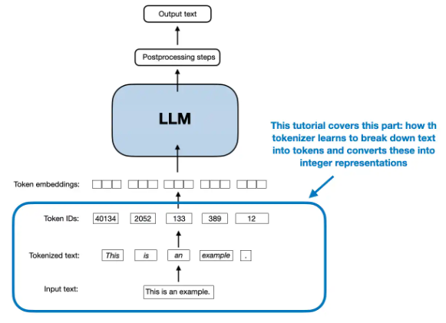
M01.1 BPE
The BPE Algorithm Explained

Slide 7
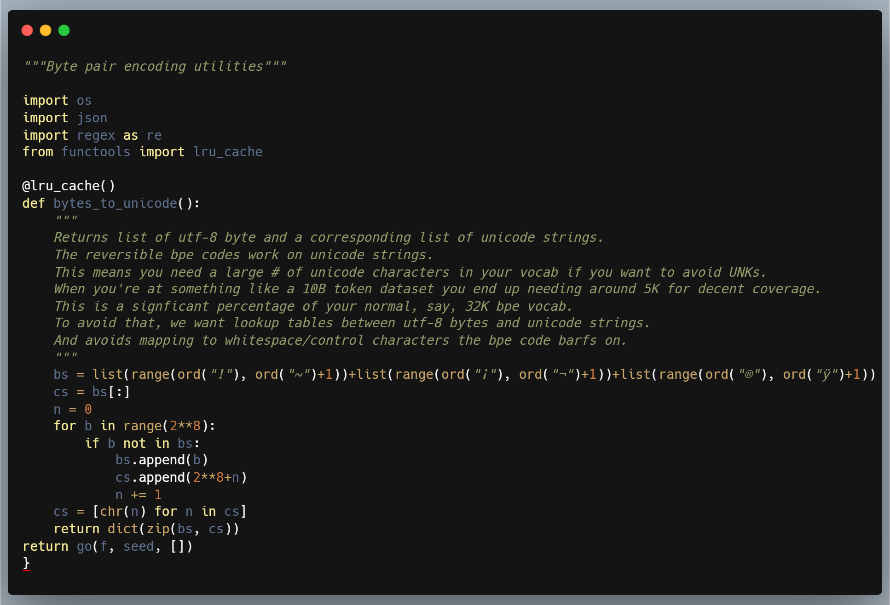
M01.1 BPE
The BPE Algorithm Explained

Slide 8
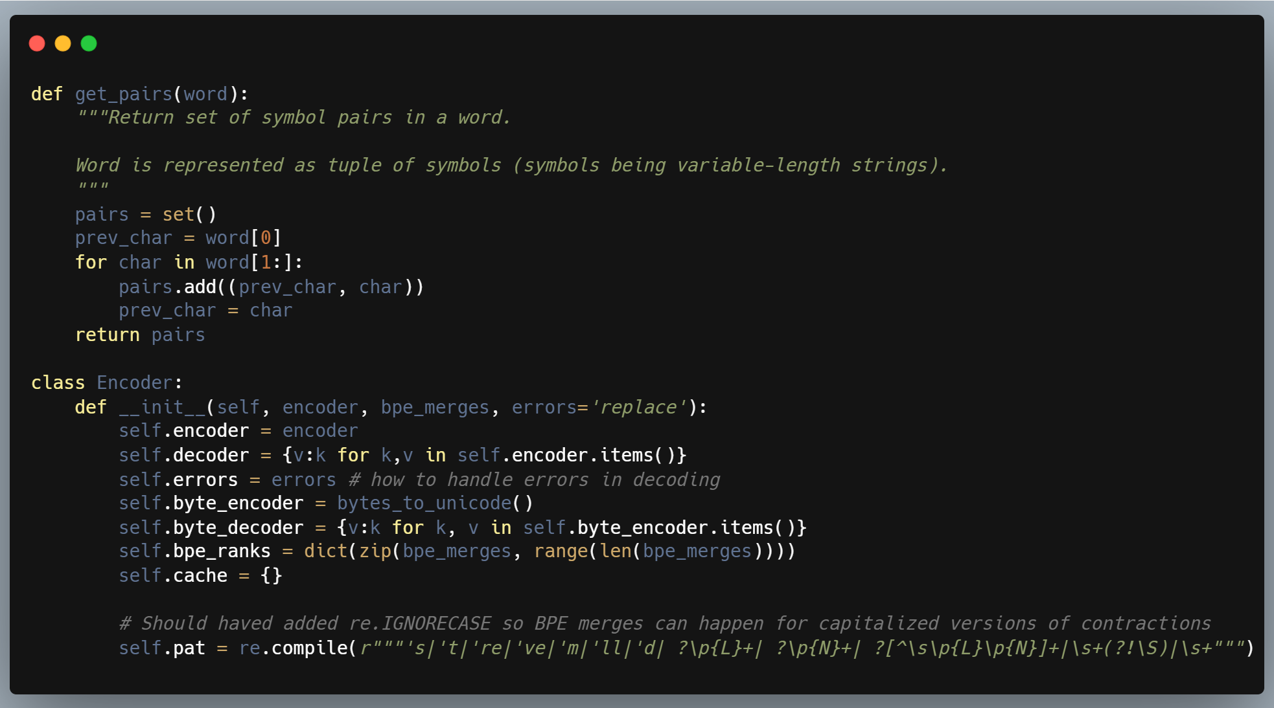
M01.1 BPE
The BPE Algorithm Explained

Slide 9
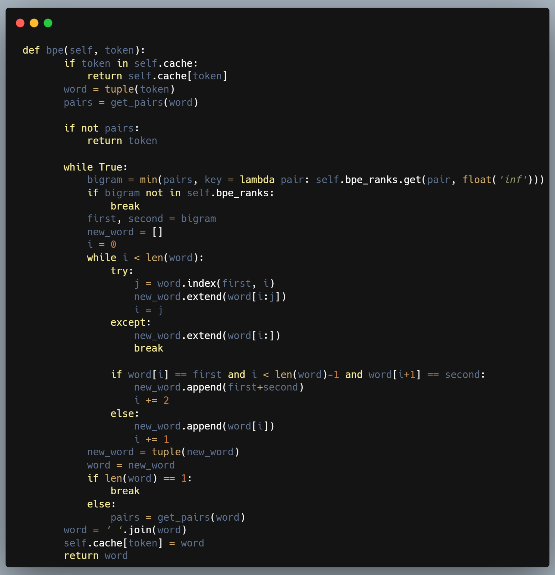
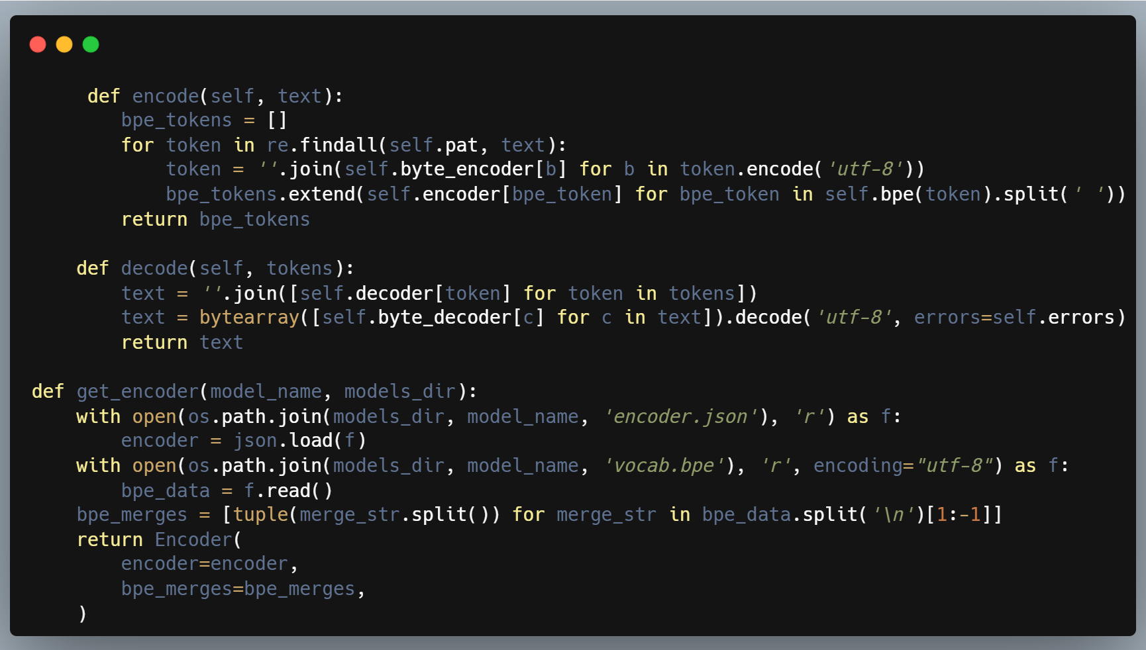
M01.1 BPE
The BPE Algorithm Explained

Slide 10
M01.1 BPE
The BPE Algorithm Explained
Model | Year | Tokenization Algorithm | Vocab Size | Features
BERT | 2018 | WordPiece | 30,522 | Standardised the subword unit for bidirectional encoders. Initial encoder-only standard.
GPT-2 | 2019 | Byte-level BPE | 50,257 | Pioneered byte-level robustness.
RoBERTa | 2019 | Byte-level BPE | 50,265 | Shifted from WordPiece to BPE for efficiency.
T5 | 2020 | Unigram (SentencePiece) | 32,128 | Utilised probability-based subword units.
GPT-3 | 2020 | Byte-level BPE | 50,257 | Maintained GPT-2 tokenization structure.
Llama 2 | 2023 | BPE (SentencePiece) | 32,000 | Balanced vocabulary for compute efficiency.
GPT-4 | 2023 | Byte-level BPE (cl100k_base) | 100,277 | Significant efficiency gains in non-English text. Achieved superior compression for polyglot and technical corpora.
Gemini 1.0/1.5 | 2023 | BPE (SentencePiece) | 256,000 | Massive vocabulary for diverse modality integration. Massive entry scale supporting million-token context windows.
Llama 3 / 3.1 | 2024 | Byte-level BPE (tiktoken) | 128,256 | Adopts the larger, more efficient tiktoken-style vocab. Refined the token-to-word ratio for open-weights efficiency.
GPT-4o | 2024 | Byte-level BPE (o200k_base) | 200,000 | Drastically reduced token counts for Asian languages. Drastic reduction in token latency for Indo-Aryan and CJK scripts.

Slide 11
M01.1 BPE
The BPE Algorithm Explained
Model | Year | Tokenization Algorithm | Vocab Size | Features
Llama 4 | 2025 | Dynamic BPE | 160,000 | Introduced adaptive tokenisation for improved reasoning stability.
Claude 4 | 2025 | Byte-level BPE | 185,000 | Optimised for long-form nuanced literary and legal analysis.
Gemini 2.0 | 2025 | Multimodal Tokeniser | 512,000 | Merged discrete audio/visual tokens into a unified latent space.
GPT-5 (Preview) | 2025 | Neural Tokenisation | 256,000+ | Shifted toward learned semantic units rather than static clusters.

Slide 12
M01.1 BPE
2025 paradigm shifts in tokenization
Unified Multimodal Vocabularies: Models like Gemini have moved away from disparate tokenisers. They now utilize a single, massive vocabulary that represents not just text, but native audio and visual "words" (often referred to as patches or frames) within the same index.
Semantic Density: The trend has moved towards larger vocabularies ($>200,000$ tokens). This reduces the computational "tax" on non-English languages, where 2025 models now achieve near-parity in token-per-word costs across most major global dialects.
The Rise of Neural Tokenisation: Frontier models (GPT-5 and beyond) have begun experimenting with Neural/Learned Tokenisers. Unlike the static algorithms of 2018–2023, these systems can adapt how they segment text based on the semantic context, further blurring the line between tokenisation and model inference.

Slide 13
M01.1 BPE
BPE Training Process and Vocabulary Size

Slide 14
M01.1 BPE
BPE in Transformers Models (e.g. GPT)

Slide 15
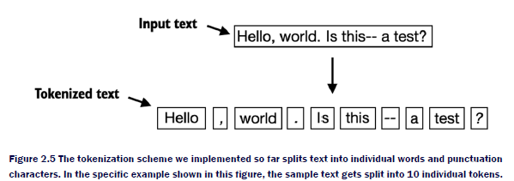
M01 TEXT PREPROCESSING
Fundamentals of tokenization
1. What is Tokenization?
2. Character vs. Word Tokenization
3. Regular Expression Tokenizers
4. Issues: Punctuation and Contractions
5. Whitespace and Rule-Based Tokenization

Slide 16
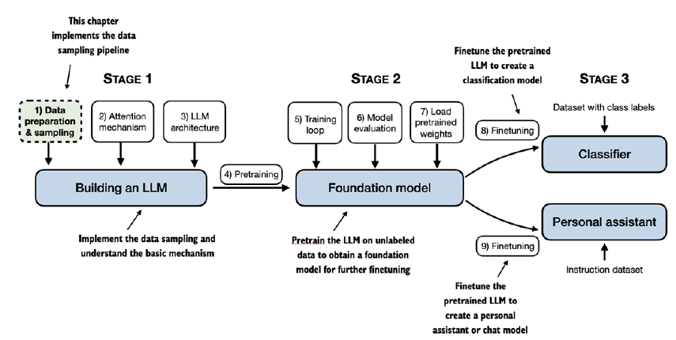
M01 TEXT PREPROCESSING
Fundamentals of tokenization

Slide 17
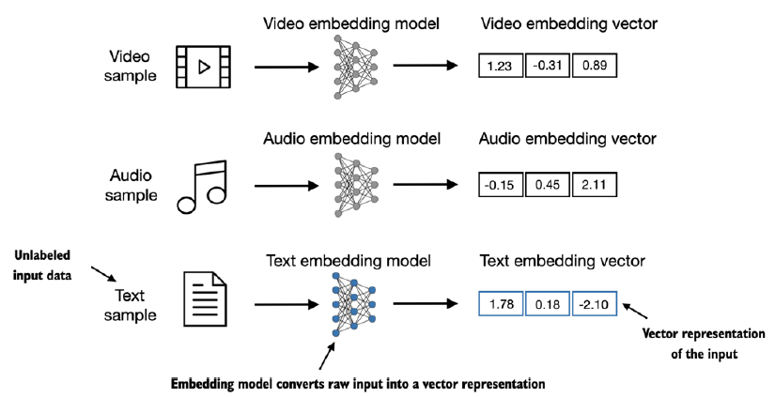
M01 TEXT PREPROCESSING
Fundamentals of tokenization

Slide 18
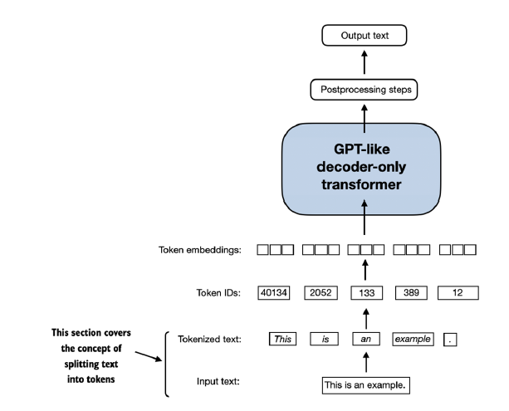
M01 TEXT PREPROCESSING
Fundamentals of tokenization

Slide 19
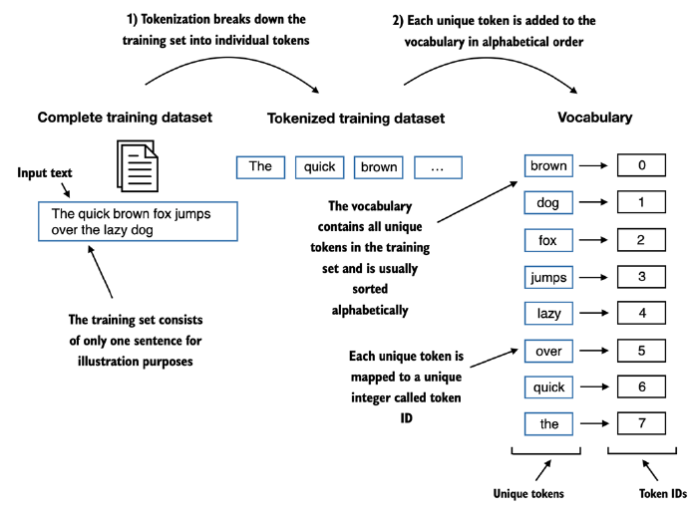
M01 TEXT PREPROCESSING
Fundamentals of tokenization

Slide 20
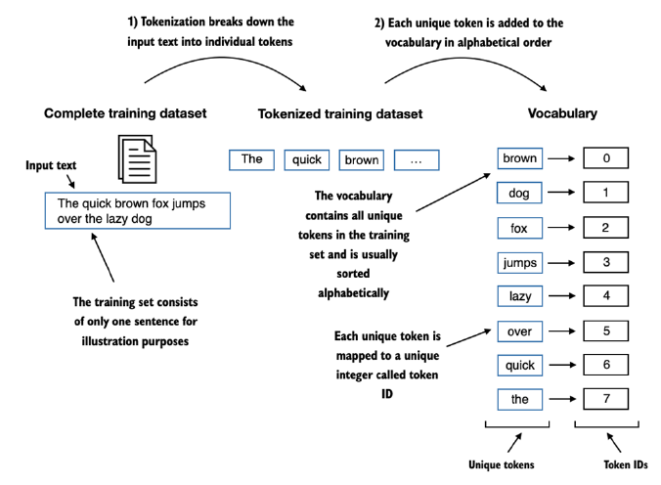
M01 TEXT PREPROCESSING
Fundamentals of tokenization

Slide 21
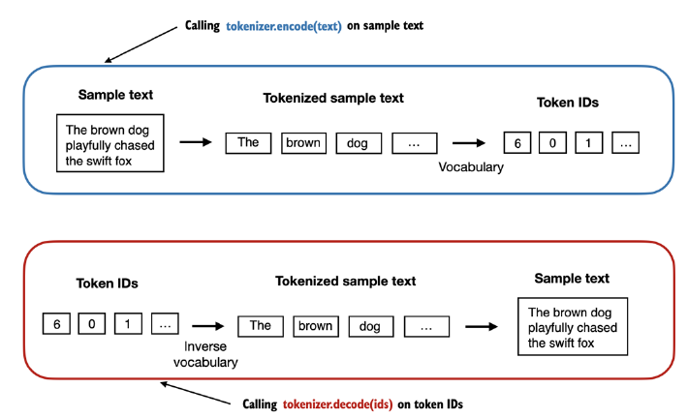
M01 TEXT PREPROCESSING
Fundamentals of tokenization

Slide 22
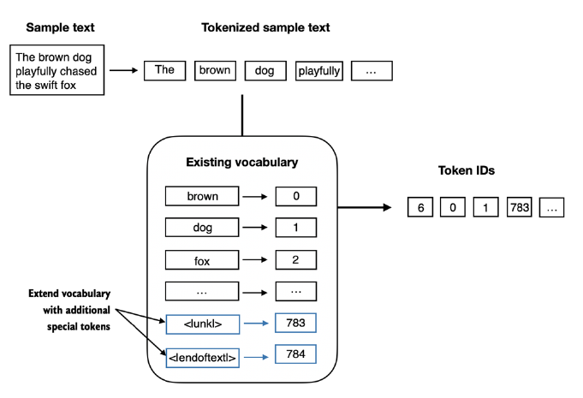
M01 TEXT PREPROCESSING
Fundamentals of tokenization

Slide 23
M01 TEXT PREPROCESSING
Byte-Pair Encoding (BPE) and Subword Tokenization
1. Introduction to Subword Tokenization
2. Why Subwords? Handling OOV (Out-of-Vocabulary)
3. The BPE Algorithm Explained
4. BPE Training Process and Vocabulary Size
5. BPE in Transformer Models (e.g., GPT)

Slide 24
M01 TEXT PREPROCESSING
Advanced Subword Tokenization with SentencePiece
1. The Need for Unsupervised Tokenization
2. SentencePiece vs. Traditional Tokenizers
3. WordPiece and Unigram Language Models
4. Key SentencePiece Features (e.g., prefixing)
5. Implementation and Use Cases

Slide 25
M01 TEXT PREPROCESSING
Stopwords and Vocabulary Management
1. Defining and Identifying Stopwords
2. Removing Stopwords: Pros and Cons
3. Contextual and Domain-Specific Stopwords
4. Alternatives to Removal: Weighting (e.g., TF-IDF)
5. Hands-on: Stopword Lists in Python

Slide 26
M01 TEXT PREPROCESSING
Processing Multilingual and Cross-Lingual Text
1. Challenges of Multilingual NLP
2. Character Sets and Encodings (e.g., UTF-8)
3. Tokenization in Different Languages
4. Cross-Lingual Transfer and Models
5. Zero-Shot and Few-Shot Multilingual Learning

Slide 27
M01 TEXT PREPROCESSING
Summary and Next Steps
Summary
Next Steps

